Slide 3
Carbonyl Condensation Reactions
Crossed Aldol Reactions
β-Dicarbonyl compounds are sometimes called active methylene compounds because they are more reactive towards base than other carbonyl compounds. 1,3-Dinitriles and α-cyano carbonyl compounds are also active methylene compounds.

Slide 4
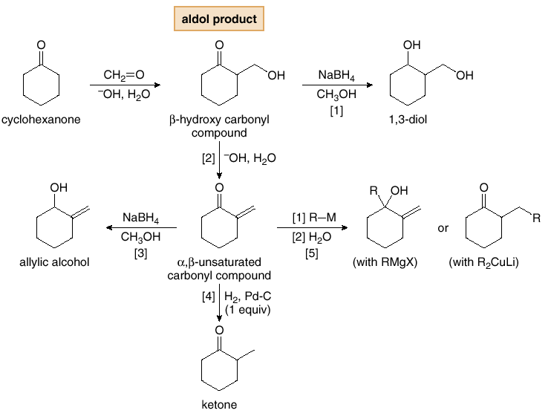
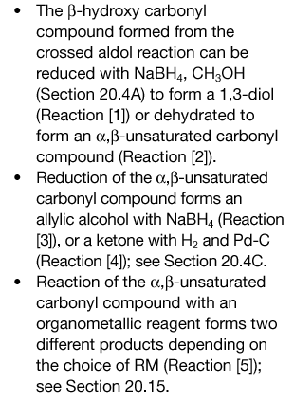
Carbonyl Condensation Reactions
Useful Transformations of Aldol Products
The aldol reaction is synthetically useful because it forms new carbon-carbon bonds, generating products with two functional groups.
β-Hydroxy carbonyl compounds formed in aldol reactions are readily transformed into a variety of other compounds.
Figure 24.3
Conversion of a β-hydroxy
carbonyl compound into other
compounds

